Slide 1
Driving Policy Transfer via Modularity and Abstraction
Presenter: Yuhan Gao
11/08/2022

Slide 2
Motivation and Main Problem
Main problem: Autonomous Driving
Simulation to Real word
Limitation: the discrepancy in sensor readings, dynamics, and environmental context between simulation and the physical world.

Slide 3
Problem Setting
Key idea: encapsulate the driving policy
not directly exposed to raw perceptual input or low-level vehicle dynamics.
Architecture: perception, driving policy, and low-level control

Slide 4
Context / Related Work / Limitations of Prior Work
Driving policies:
Modular pipelines
Hand-designed modular pipeline – deep learning
Between traditional modular pipelines and end-to-end learning

Slide 5
Proposed Approach / Algorithm / Method

Slide 6
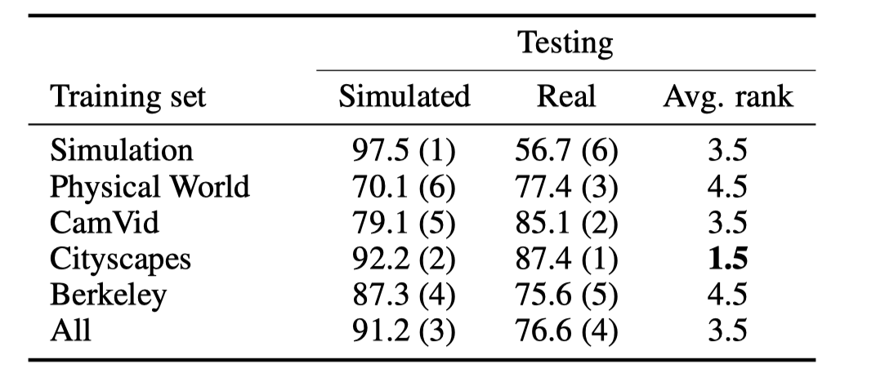
Architecture -- Perception

Slide 7
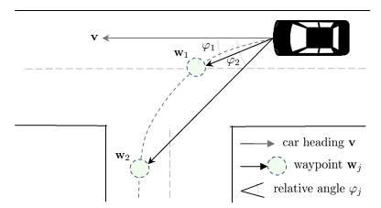
Architecture -- Driving Policy
observation-command-action tuples
deep network

Slide 8
Architecture -- Control
U(t): control input
e(t): error
PID_{t},PID_{s}
Notes:
In order to convert the waypoints into control signals for the vehicle, they use a PID controller
u(t) is the control input, e(t) is the error, and K p, K i, and K dare tuning parameters that correspond to proportional, integral, and derivate gains, respectively.
The low-level controls of our physical robotic truck are the throttle and the steering angle. We use a PID controller for each of the controls: one for throttle (PID t ) and one for the steering angle (PID s ). For PID t , the error is the difference between the target speed and the current speed. For PID s , the error is ϕ 1 , the oriented angle between the viewing direction and the direction towards the ﬁrst waypoint.

Slide 9
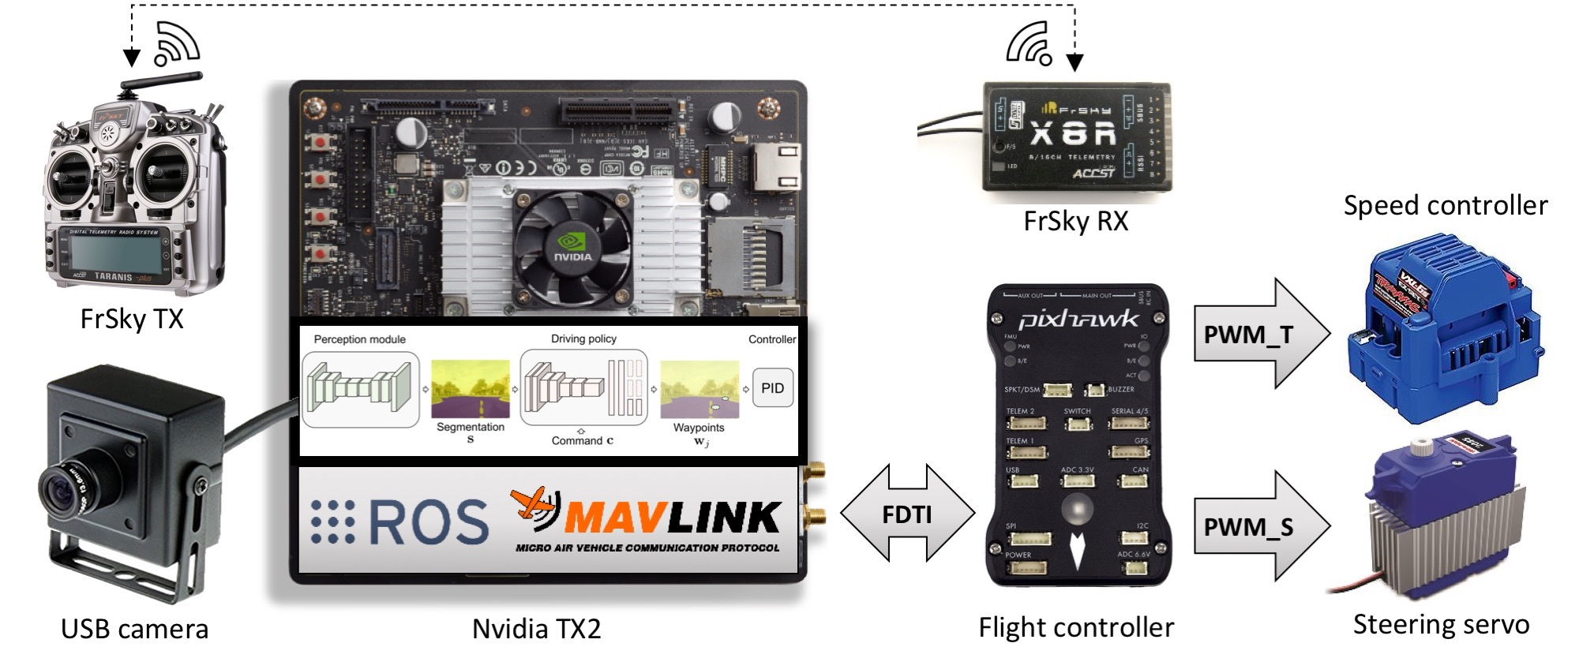
System Setup
Simulation:
CARLA
sensor data
Physical system:
1/5 scale Traxxas Maxx truck
Image->Flight controller
->speed controller and
Steering servo

Slide 10
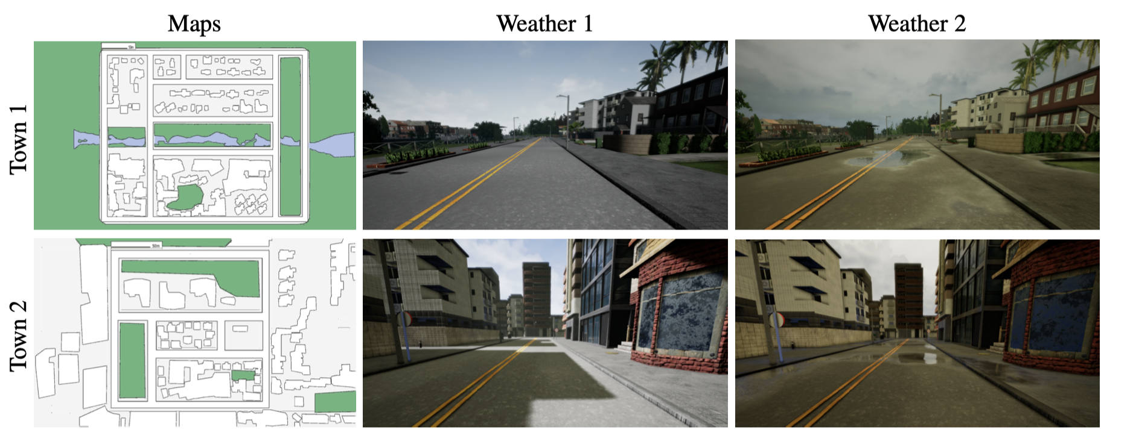
Experiments – Driving in simulation

Slide 11
Experimental Results
• Image to control (img2ctrl): Predicts low-level control directly from color images.
• Image to waypoint (img2wp): Predicts waypoints directly from color images.
• Segmentation to control (seg2ctrl): We pre-train the perception module on Cityscapes and ﬁx it. We then train a driving policy to predict low-level control from segmentation maps produced by the perception module.
• Segmentation to waypoint (ours): Our full model predicts waypoints from segmentation maps produced by the perception module.

Slide 12
Experiments – Driving in physical world
1-3 slides
Description of the experimental evaluation setting
What is the domain(s), e.g., datasets, tasks, robot hardware setups?
What are the baseline(s)?
What scientific hypotheses are tested?

Slide 13
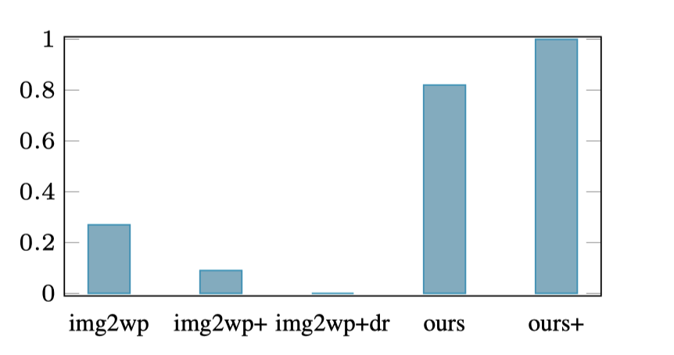
Experimental Results

Slide 14
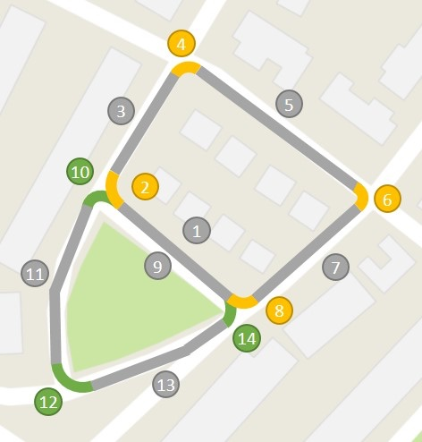
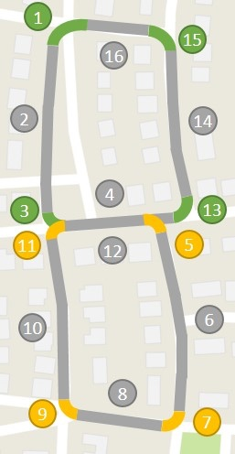
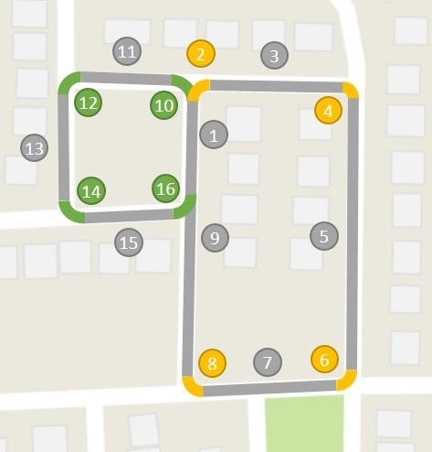

Slide 15
Critique / Limitations / Open Issues
Simplified scenario
Missing some important information in real world
low-level controller we used is quite simple
the use of data-hungry learning algorithms

Slide 16
Future Work for Paper / Reading
Simulation-Based Reinforcement Learning for Real-World Autonomous Driving Bła˙zej Osi´nski et al.
Urban Driving with Conditional Imitation Learning Jeffrey Hawke etal.

Slide 17
Extended Readings
End-to-End Urban Driving by Imitating a Reinforcement Learning Coach Zhejun Zhang et al.(2021)
End-To-End Multi-Modal Sensors Fusion System For Urban Automated Driving Ibrahim Sobh et al.
Simulation to Scaled City: Zero-Shot Policy Transfer for Traffic Control via Autonomous Vehicles Kathy Jang et al.

Slide 18
Summary
Transferring driving policies from simulation to reality
Autonomous driving have high sample complexity and are difﬁcult to scale to realistic urban driving
Requires large dataset, time-consuming, not sufficient/challenging for urban driving
Encapsulate the driving policy such that it is not directly exposed to raw perceptual input or low-level vehicle dynamics
Both simulation and physical experiments evaluation

